Slide 1
MIOT.CC
Minimally Invasive Organ Transplant Consensus Conference (MIOT.CC)
12-14 December 2024, Riyadh, Saudi Arabia
Chairs
Prof. Dieter C. Broering & Prof. Enrico Benedetti
Organ Transplant Center of Excellence, Riyadh, Saudi Arabia | Division of Transplantation, University of Illinois, Chicago, USA.

Slide 2
MIOT.CC
Minimally Invasive Organ Transplant Consensus Conference (MIOT.CC)
12-14 December 2024, Riyadh, Saudi Arabia
Join us for a groundbreaking three-day conference featuring
Day 1: Live demonstrations of minimally invasive liver & kidney, donor & recipient techniques.
Day 2: Expert-led consensus formation on kidney & liver, donor & recipient techniques.
Day 3: Insights into minimally invasive pancreas, lung, and heart, and uterus transplants.
Conference Highlights
Real-time robotic practices.
Debates on current and future minimally invasive transplantation practices.
PubMed citable co-authorship for collaborators.
Final recommendations by an independent jury following the Danish Model.
Be part of the global conversation on advancing transplant medicine.
Information: https://MIOT.CC
12-14 December 2024, Riyadh, Saudi Arabia

Slide 3
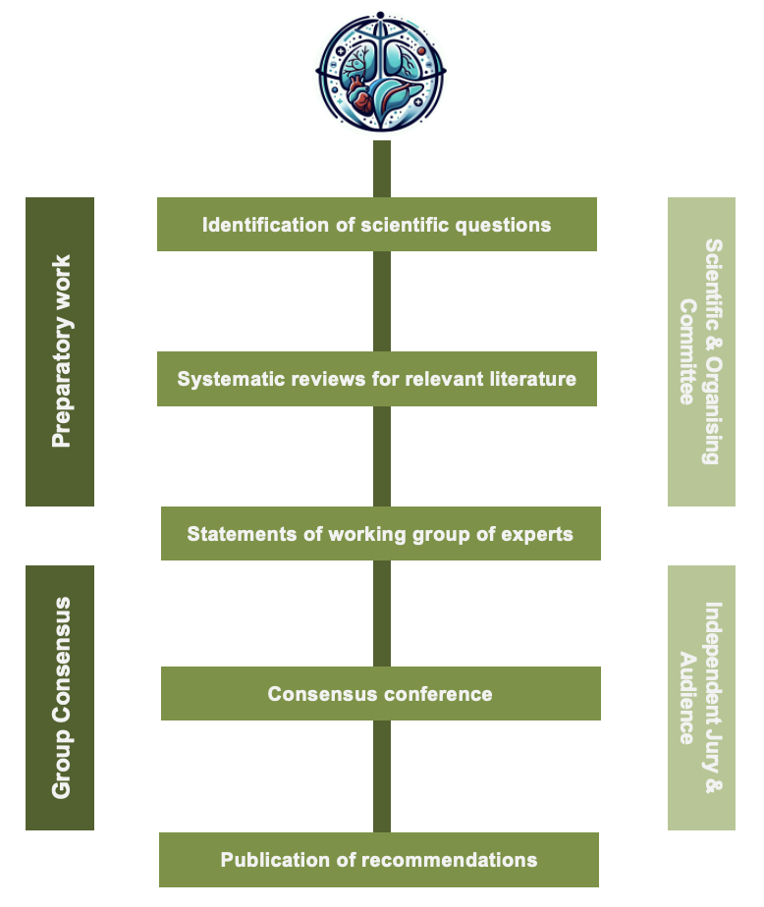
Danish Model of Consensus
MIOT.cc

Slide 4
Scoping Review
miot.cc/instructions
A scoping review maps out the main concepts and gaps in research on a topic, while a systematic review critically evaluates and synthesizes findings to answer a specific question in a more strict methodological way.
Guidelines summary
Define your research question based on the topic allocated to your panel.
Determine the scope and inclusion/exclusion criteria.
Develop a search strategy using relevant keywords.
Conduct the literature search in databases such as PubMed / Google Scholar.
Screen and select studies based on the criteria.
Extract relevant data from selected studies, qualitative information adequate.
Organize the information into meaningful groups or themes.
Summarize the results by identifying patterns and gaps.
https://miot.cc/instructions

Slide 5
GRADE Approach
miot.cc/instructions
Grade recommendations by using a two-level system: Strong and Conditional
Strong Recommendation
When the benefits of an intervention clearly outweigh the potential harms
A strong recommendation indicates that most patients should receive the recommended intervention
Conditional Recommendation
This is used when the balance between benefits and potential harms is less certain
or when patient values and preferences may vary.
A conditional recommendation indicates that different options may be reasonable, and the decision should be based on individual patient circumstances, values, and preferences.
https://miot.cc/instructions

Slide 6
Next Steps
Zoom Meeting with your Panel
MIOT.cc

Slide 7
Next Steps
Scoping Review of the Literature
MIOT.cc

Slide 8
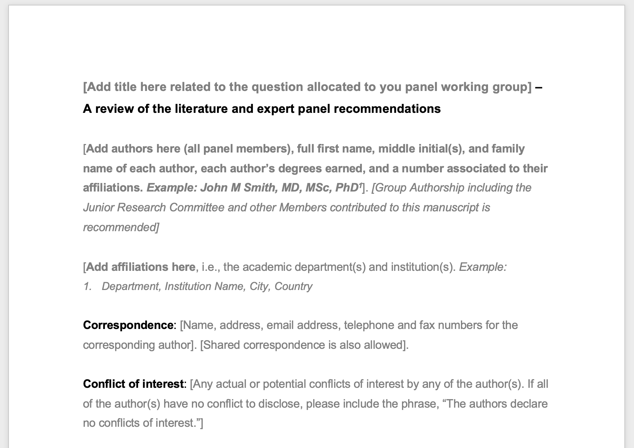
Next Steps
Manuscript Template as a Guide
MIOT.cc

Slide 9
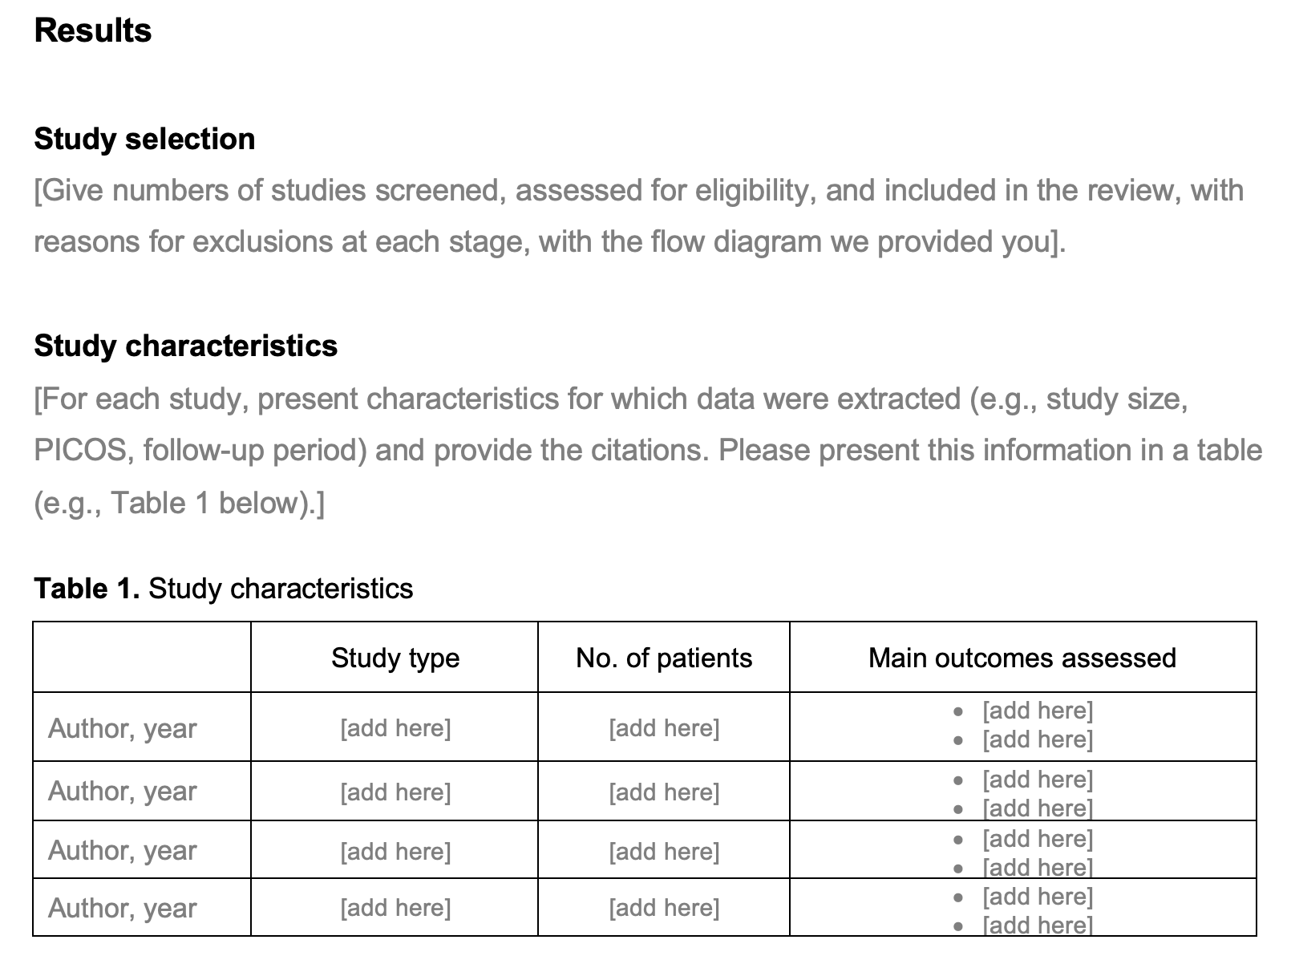
Table 1. Study Characteristics
Manuscript Template as a Guide
MIOT.cc

Slide 10
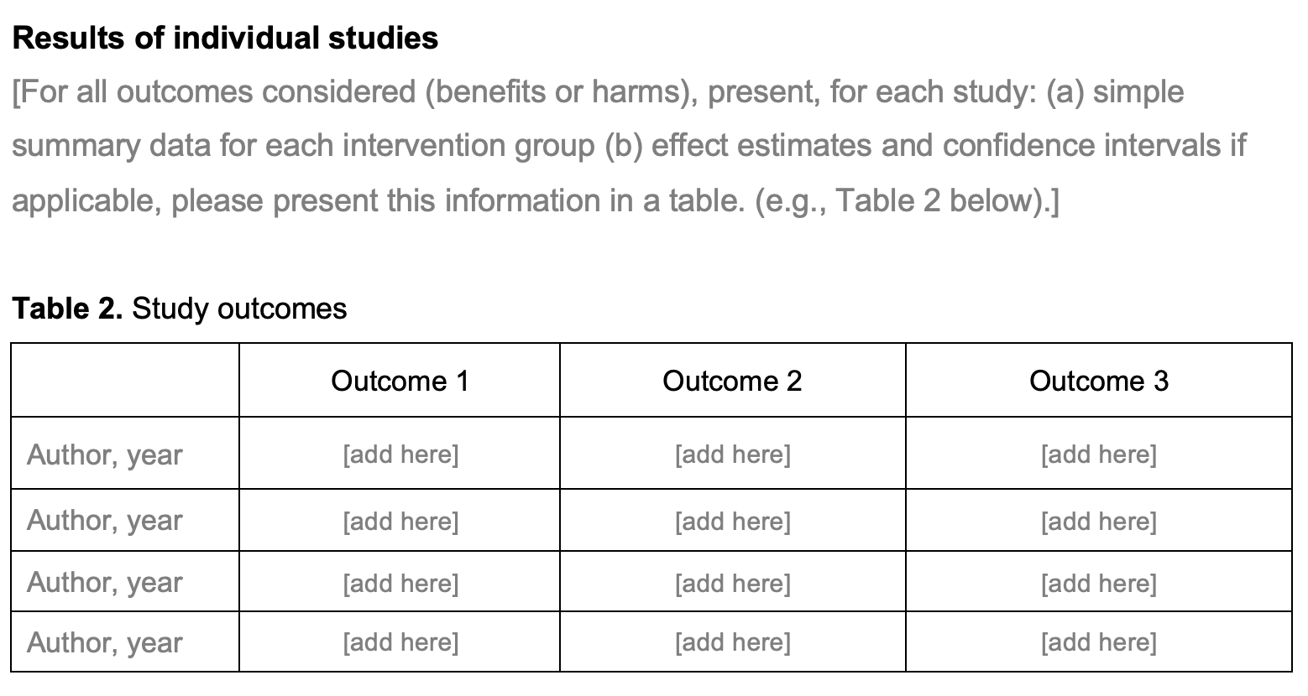
Table 2. Study Outcomes
Manuscript Template as a Guide
MIOT.cc

Slide 11
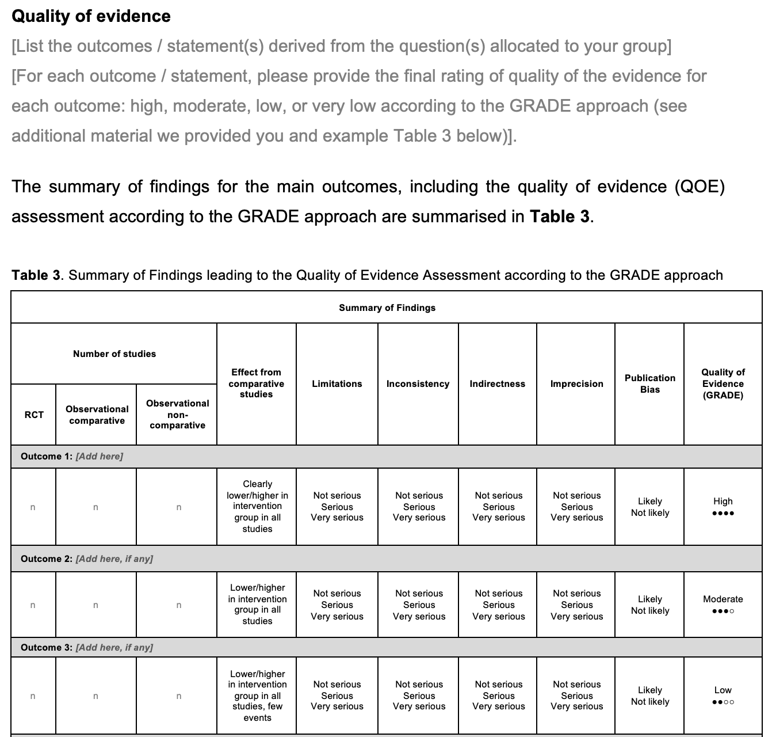
Table 3. Quality of Evidence
Manuscript Template as a Guide
MIOT.cc
Notes:
Effect estimate from comparative studies: This is an quiatlitive (not quantitative) evaluation of the effect estimate / size derived from comparative studies. Examples are shown above on such assessments. Limitations: Make a judgement on the risk of bias across studies for an individual outcome. It is possible to consider the size of a study, its risk of bias and the impact it would have on the summarised effect. Inconsistency: Evaluate the difference in the magnitude of effects across studies. Widely differing estimates of the effects indicate inconsistency. Indirectness: Make a global judgement on how dissimilar the research evidence is to the clinical question at hand (in terms of population, interventions and outcomes across studies). Imprecision: Consider the optimal information size (or the total number of events for binary outcomes and the number of participants in continuous outcomes) across all studies. Results may also be imprecise when the confidence intervals (CI) of all the studies or of the largest studies include no effect and clinically meaningful benefits or harms. Publication bias can be suspected when the body of evidence consists of only small positive studies or when studies are reported in trial registries but not published. Statistical evaluation of publication bias is not possible in this case. Publication bias can be suspected when the body of evidence consists of only small positive studies or when studies are reported in trial registries but not published.

Slide 12
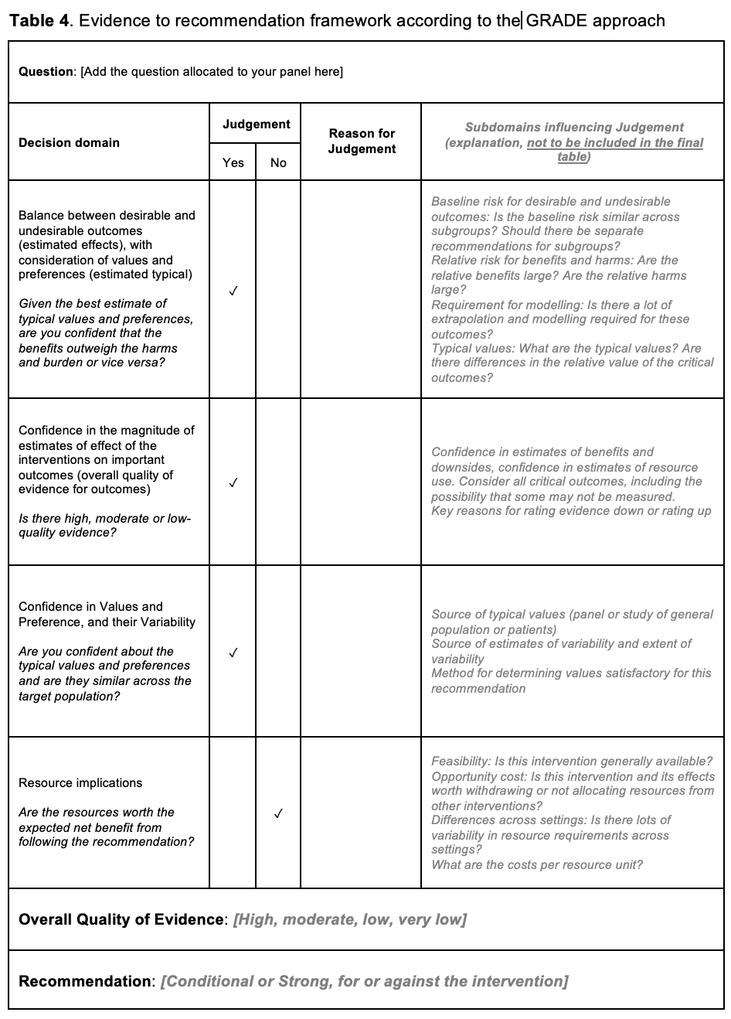
Table 4. Evidence to Recommendations Framework
MIOT.cc

Slide 13
Presentation Template
[Add title here]
[Add authors here, as they should appear in the manuscript]
[Add Affiliations here as they should appear in the manuscript]
[Add conflicts of interest statement here]
MIOT.cc

Slide 14
Background
[The topic being addressed]
[What is known?]
[What is not known?]
MIOT.cc

Slide 15
Objectives
[What did you do?]
Provide international expert panel recommendations.
MIOT.cc

Slide 16
Methods
Scoping review of the literature
Recommendations using the simplified and modified GRADE approach
[You may add additional information here regarding the scoping review if you wish, such as
Study eligibility criteria
Participants
Interventions
Study appraisal and synthesis methods
Please keep it short, in bullet points.]
MIOT.cc

Slide 17
Results
[Number of studies included]
[Main study characteristics]
[List of main outcomes assessed, examples]
Overall morbidity
Specific complication (e.g., biliary)
Hospital stay
Mortality
Etc.
MIOT.cc

Slide 18
Results
Study outcomes table (optional, if you wish you may present the findings in a different format)
Summary of Findings
Number of studies |  |  | Quality of Evidence (GRADE)
RCT | Observational comparative | Observational non-comparative
Outcome 1 (e.g., Overall complication rate): [Add here]
n | n | n | High ●●●●
Outcome 2 (e.g., SFS Syndrome Rate): [Add here, if any]
n | n | n | Moderate ●●●○
Outcome 3 (e.g., mortality rate: [Add here, if any]
n | n | n | Low ●●○○
Outcome 4: [Add here, if any]
n | n | n | Low ●●○○
Outcome 5: [Add here, if any]
n | n | n | Very low ●○○○
[Please feel free to comment regarding the effect, limitations, inconsistency, indirectness, imprecision, and publication bias verbally when describing the Quality of Evidence if you wish.]
MIOT.cc

Slide 19
Results
Study outcome 1 (optional) (e.g. Overall complication rate)
Question: [Add the question allocated to your panel here]
Decision domain | Judgement |  | Reason for Judgement
 | Yes | No
Estimated effects: Balance between desirable and undesirable outcomes? | ✓ |  | Most case reports did not report deaths, and only the larger studies reported unfavorable outcomes. This indicates a generally favorable balance, although larger studies and registries need further examination
Quality of evidence for outcomes: Confidence in the effect of the interventions on important outcomes? | ✓
Confidence in Values and Preference, and their Variability: Similar across the target population? | ✓
Resource implications: Are the resources worth the benefit when following the recommendation? |  | ✓
Overall Quality of Evidence: [High, moderate, low, very low] [For the specific question taking under consideration the QOE from all outcomes]
Recommendation: [Weak or Strong, for or against the intervention]
[Each outcome (when multiple) may be presented in separate tables and slides]
MIOT.cc

Slide 20
Results
Example
Question: How do Enhanced Recovery After Surgery protocols affect short-term outcomes in Liver Transplantation?
Decision domain | Judgement |  | Reason for Judgement | Subdomains influencing Judgement (Andrews et al., 2013)
 | Yes | No
Balance between desirable and undesirable outcomes (estimated effects), with consideration of values and preferences (estimated typical) Given the best estimate of typical values and preferences, are you confident that the benefits outweigh the harms and burden or vice versa? | ✓ |  | The desirable consequences are substantial (including significant reduction of overall complications, ICU and hospital length of stay), and valued highly. The undesirable consequences, inconvenience and burden for patients (including potentially higher efforts for patients and institutions when implementing ERAS protocols) are relatively minor when compared to the desirable consequences (morbidity) | Baseline risk for desirable and undesirable outcomes: Is baseline risk similar across subgroups? Should there be separate recommendations for subgroups? Relative risk for benefits and harms: Are relative benefits / harms large? Requirement for modeling: Is there a lot of extrapolation and modeling required for outcomes? Typical values: What are the typical values? Differences in the relative value of critical outcomes?
Confidence in the magnitude of estimates of effect of the interventions on important outcomes (overall quality of evidence for outcomes) Is there high or moderate quality evidence? |  | ✓ | Reduced overall complications, ICU and hospital length of stay with ERAS: moderate ●●●○ Reduced mortality in ERAS: low ●●○○ Increased hospital readmission rate in ERAS: low ●●○○ | Confidence in estimates of benefits and downsides, confidence in estimates of resource use. Consider all critical outcomes, including the possibility that some may not be measured. Key reasons for rating evidence down or rating up
Confidence in Values and Preference, and their Variability Are you confident about the typical values and preferences and are they similar across the target population? | ✓ |  | We can be confident that patients with ESLD listed or undergoing LT place a high value on avoiding complications and mortality. The inconvenience of potentially higher efforts for patients and institutions when implementing ERAS protocols is generally considered lower than the value on avoiding complications. These estimations are based on the clinical experience of all authors, derived from varying clinical, ethnical, age and gender backgrounds. | Source of typical values (panel or study of general population or patients). Source of estimates of variability and extent of variability. Method for determining values satisfactory for this recommendation.
Resource implications Are the resources worth the expected net benefit from following the recommendation? | ✓ |  | The resources required to establish comprehensive ERAS protocols are rated lower than the probable net reduction in costs resulting from decreased ICU and hospital length of stay, as described in 1 included paper (King et al., 2018) and known from ERAS programs in other surgical settings, and given the desirable outcomes | What are the costs per resource unit? Feasibility: Is this intervention generally available? Opportunity cost: Is this intervention and its effects worth withdrawing or not allocating resources from other interventions? Differences across settings: Is there lots of variability in resource requirements across settings?
Overall Strength of Recommendation | Strong For |  | Considering all decision domains, the guideline panel recommends that comprehensive and standardized ERAS for LT programs should be developed and implemented.
Evidence to Recommendation Synthesis | The i) high confidence in the mainly moderate magnitude of effect on highly valued outcomes, ii) moderate confidence that undesirable outcomes are present, and iii) high confidence in benefits regarding resource implications, suggest a strong recommendation
MIOT.cc

Slide 21
Recommendations
miot.cc/instructions
[Decide on the direction (for/against) and grade strength (strong/conditional) of your statement(s) and recommendation(s). Consider the following according to the GRADE approach:
Quality of the evidence
Balance of desirable/undesirable outcomes
Values and preferences
Resource implications
[Example: Enhanced recovery programs are related to improved short-term outcomes after liver transplantation (Quality of Evidence; Low | Grade of Recommendation; Strong)].
The direction and strength of recommendation was rated as strong/conditional for/against [add intervention here] with regard to [add outcomes here].
[Please use a single slide for each recommendation, if multiple to facilitate discussion]
[Each recommendation will be voted by the audience during the conference]
[If you have any questions, please do not hesitate to contact us at any time].
Thank you,
The MIOT Consensus Conference Team
https://miot.cc/instructions
MIOT.cc

Slide 22
Thank You!!!
12-14 December 2024, Riyadh, Saudi Arabia

